Slide 1
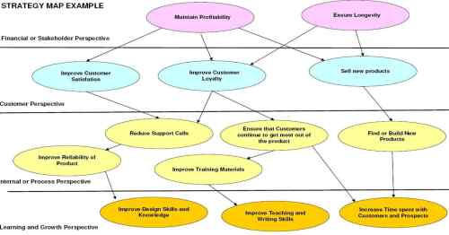
Water Services Trust Fund
DTF Business Model Workshop – Part 2
What is
a Business Strategy?
How to
Do a SWOT Analysis?
Develop a Strategy Map?
Notes:
This is a participatory workshop. Input is expected from all participants .
The presentation is a guiding tool for the facilitator and the group. Group work and group presentations shold happen “analogue” on pin boards, working with Cards, Markers and sheets of papers. The facilitator can give examples to get the groups inspired. The idea is to have creative and inspired discussions that are not distracted by the presence of computers and powerpoint effects.
Note for facilitator: read the note section as guide through your presentation.

Slide 2
Business Strategy Introduction
According to you, what is a Business Strategy?
Notes:
Recap of Part 1 of the workshop
Collect the definitions on the pin board and compare, open the discussion.
Comment for facilitator: Business model is part of the business strategy:
business model is a description of how your business runs, Business strategy is the way how you will achieve the overall business goal (vision)

Slide 3
Business Strategy Introduction
A Business Strategy is….
… a long term plan of action designed to achieve a particular goal or set of goals or objectives.
“… a pattern in a stream of decisions”
Henry Mintzberg
“ A good strategy provides a clear roadmap, consisting of a set of guiding principles or rules, that defines the actions people in the business should take (and not take) and the things they should prioritize (and not prioritize) to achieve desired goals.”
Michael Watkins

Slide 4
How to develop a Business Strategy
Vision Statement
Mission Statement
SWOT Analysis
Balanced Scorecard
Goals / Objectives
Strategy Map
Key Performance Indicators (KPI)
Dashboard to monitor KPI

Slide 5
Vision and Mission
Vision
describes a picture of the company's future and the direction it is headed
Mission
a statement of the company's, team's or organisation's purpose. It describes what business the company is in and the customer needs it is trying to meet.

Slide 6
SWOT Analysis
SWOT
Strengths
- Internal
- Characteristics of the business or project that give it an advantage over others
Opportunities
- External
- elements in the environment that the business could exploit to its advantage
Weaknesses
- Internal
- Characteristics of the business that place the business or project at a disadvantage relative to others
Threats
-External
- elements in the environment that could cause trouble for the business
Notes:
Each Aspect of the canvas will be explained and defined in the following.

Slide 7
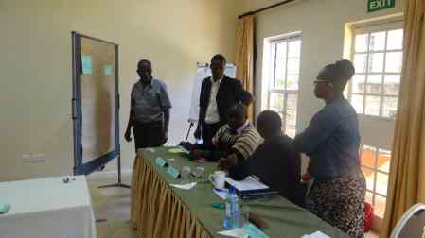
Group Work
Group 1:
Strengths and Weaknesses
Group 2:
Opportunities and Threats
Discuss for 30 minutes
1 group leader to guide
discussion and present
1 secretariate to take notes
Presentations
Each group 10 minutes

Slide 8
Balanced Scorecard
a methodology for managing a business or organisation
looks back up the process of generating the finances of the company to find vital non financial measures
4 Perspectives:
Financial – Internal Business Processes
Customer / Market – Learning, Innovation and
Growth

Slide 9
Goals / Objectives for Strategy Map
For each perspective you establish goals or objectives
Form a consolidated and coherent structure or strategy map of objectives that support one another to bring the company organisation to meet their commitments to their stakeholders.
… a drawing that enables you to link actions or objectives into a coherent, logical structure that shows the cause and effect link between your objectives or actions.

Slide 10
Example Strategy Map

Slide 11
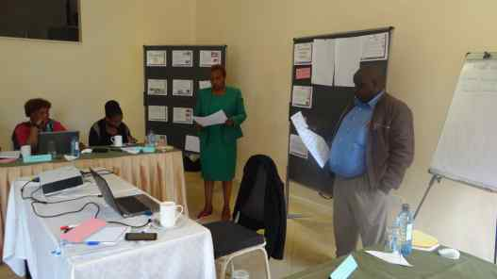
Group Work
2 Groups:
Create a Strategy Map for a DTF
Discuss for 1hour
1 group leader to guide discussion and present
1 secretariate to take notes
Presentations
Each group 20
minutes

Slide 12
Key Performance Indicators (KPI)
financial and non-financial metrics
help to define and measure progress toward goals
Measure performance before it is too late
Each of the main goals has indicators
E.g. scheduling 3 small exhauster trucks per day vs. The actual number of trucks scheduled

Slide 13
Group Work
2 Groups:
Based your the Strategy Map, develop KPI
Discuss for 1hour
1 group leader to guide discussion and present
1 secretariate to take notes
Presentations
Each group 20 minutes

Slide 14
Dashboards
Tool to help monitor the performance toward set goals
Based on KPI
Digital
Notes:
This is probably not possible for the average DTF, due to lack of resources and skill. However, woth mentioning to understand the whole concept.

Slide 15
What have we achieved today?
Understanding of Business Strategy Development
Conducting a SWOT Analysis for a DTF
Developing a Strategy Map and KPI for a DTF
What else have we achieves or learnt? (voicing, your comments)

